Slide 1
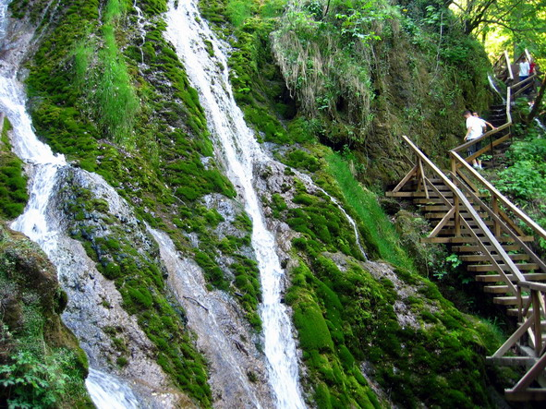
Nature Parks Croatia
Made by: Ivana Lepen, 6th grade
Osnovna škola Vladimira Nazora Pribislavec, Croatia
May 2016
eTwining project
Where is my green environment?

Slide 2
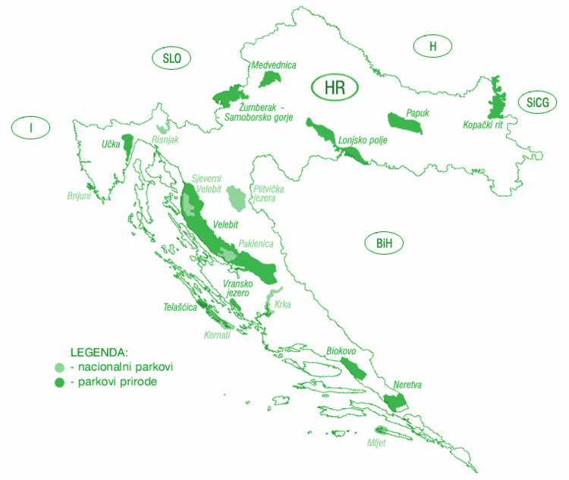
The main protected areas of Croatia are national parks, nature parks and strict reserves. There are 444 protected areas of Croatia, encompassing 9% of the country. Those include 8 national parks in Croatia, 2 strict reserves and 11 nature parks.

Slide 3
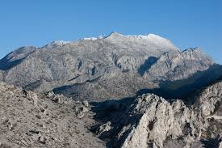
Biokovo
Nature Park was declared in 1981, with an area of 195.5 km2. The highest point of the park St George with 1762 meters above sea level is also the highest peak of the mountain slope and the third highest peak in Croatia.

Slide 4
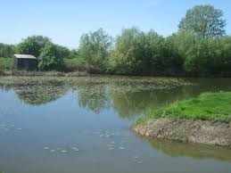
Kopački rit
Kopački rit is a nature park in eastern Croatia in municipalities of Bilje and Kneževi Vinogradi. It is located northwest of the confluence of the Drava and the Danube, situated at the border with Serbia.

Slide 5
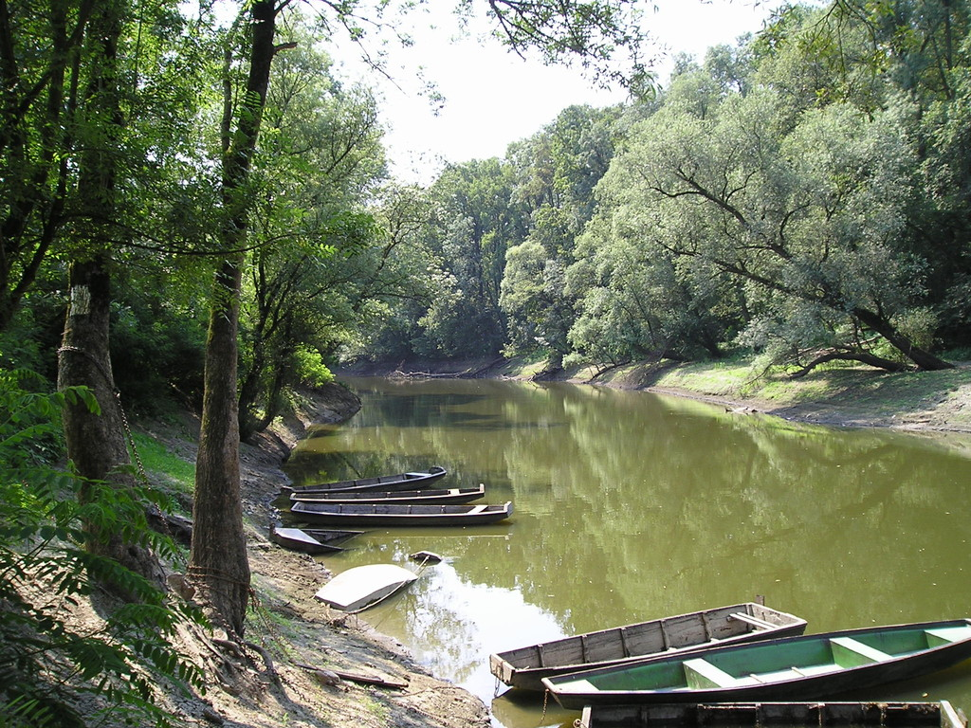
Lonjsko polje
Lonjsko polje is the largest protected wetland in both Croatia and the entire Danube basin. It covers an area of 505.6 square kilometres.

Slide 6
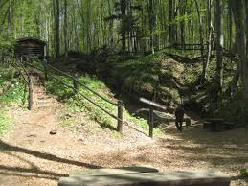
Medvednica
Medvednica is a mountain in central Croatia, just north of Zagreb and marking the southern border of the historic region of Zagorje. The highest peak, at 1.035 metres is Sljeme.

Slide 7
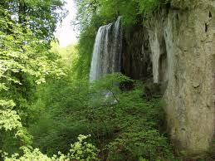
Papuk
Papuk is the largest mountain in the Slavonia region in eastern Croatia, near the city of Požega. It extends between Bilogora to the northwest, Krndija to the east, and Ravna gora and Psunj to the southwest.

Slide 8
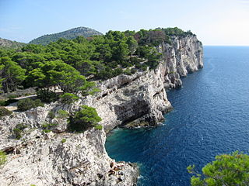
Telaščica
Telašćica is a bay that is situated in the southeastern portion of the island of Dugi Otok, Croatia in the Adriatic Sea. It is a designated nature park, full of wildlife and sea creatures.

Slide 9
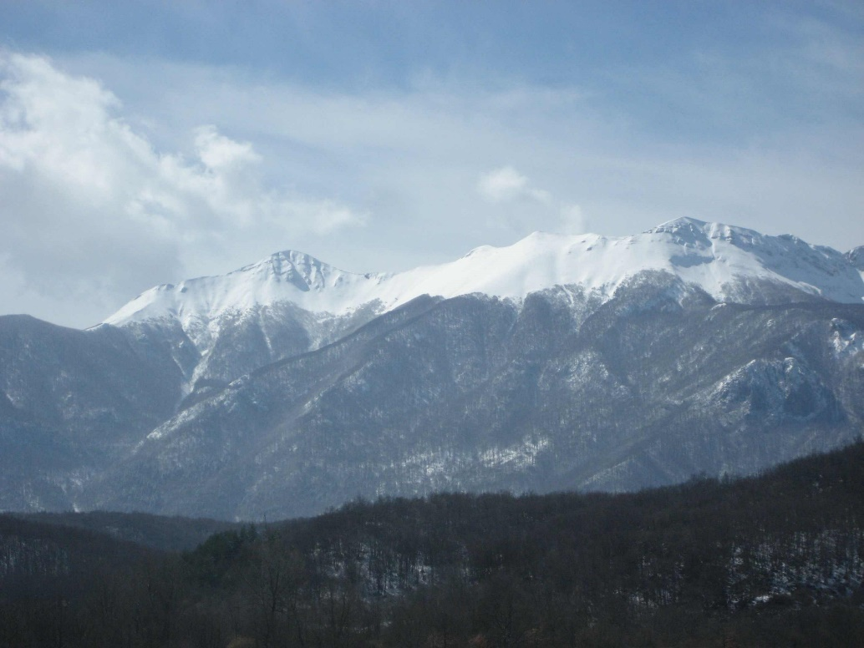
Velebit
The Northern Velebit National Park is a national park in Croatia that covers 109 km² of the northern section of the Velebit mountain, the largest mountain in Croatia. Because of the abundant variety of this part of the Velebit range and its authenticity, the area was upgraded from its classification as a nature reserve to a national park in 1999, and started work in September the same year.

Slide 10
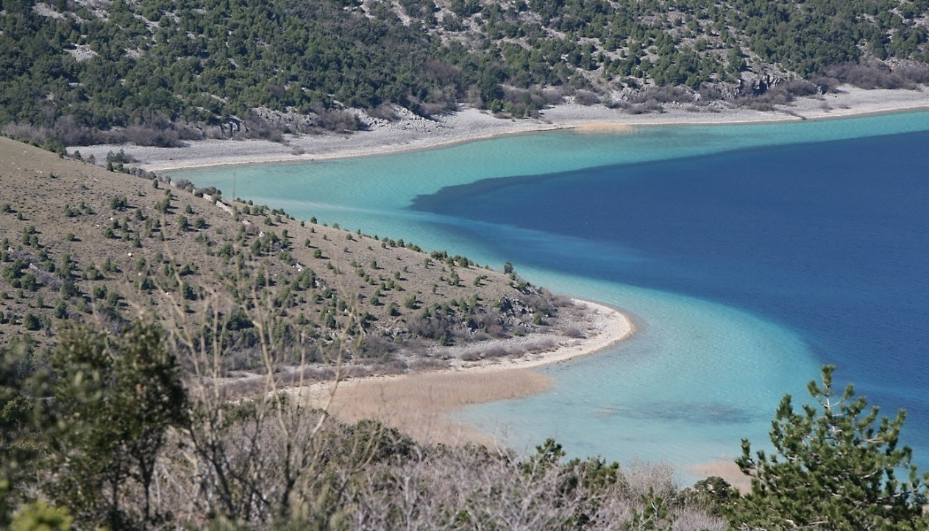
Vransko jezero
Vransko jezero in Dalmatia is the largest lake in Croatia. It is a designated nature park, a kind of protected area in Croatia. It is located in Zadar County and Šibenik-Knin County, between the towns and municipalities of Benkovac, Pirovac, Pakoštane, Stankovci and Tisno.

Slide 11
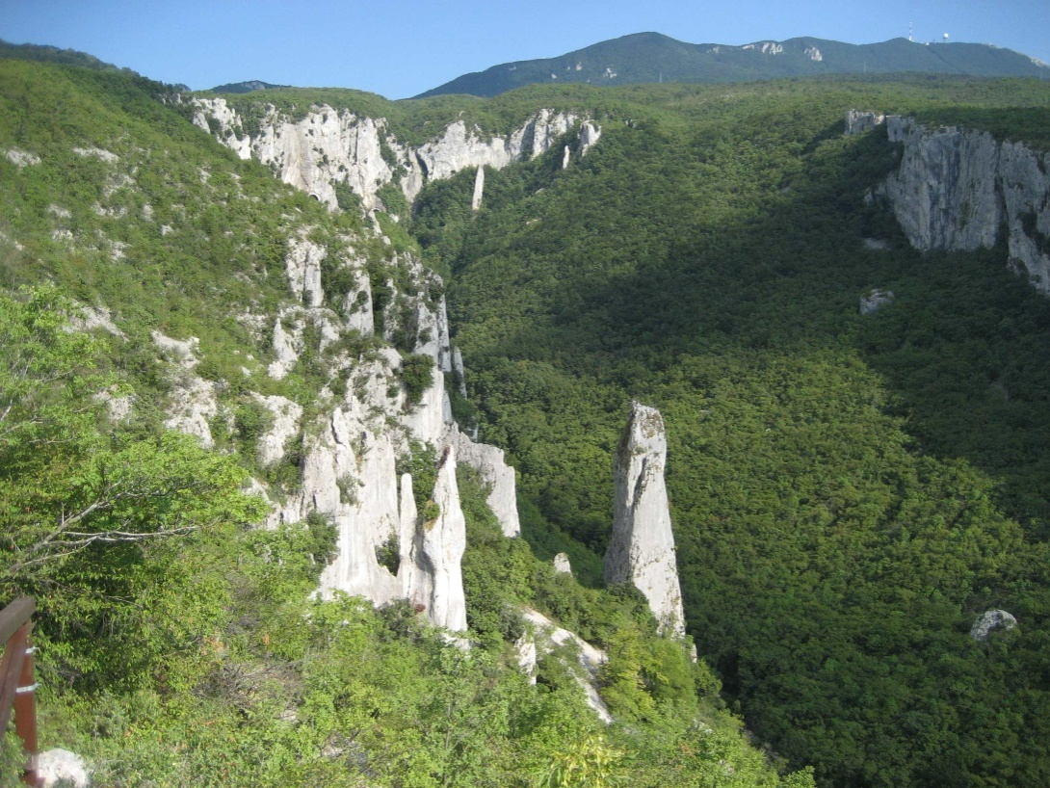
Učka
The Učka is a mountain range that rises behind Opatija riviera, on the Istrian peninsula, in northwestern Croatia. It forms a single morphological unit together with the Ćićarija range which stretches from the Bay of Trieste to Rijeka.

Slide 12
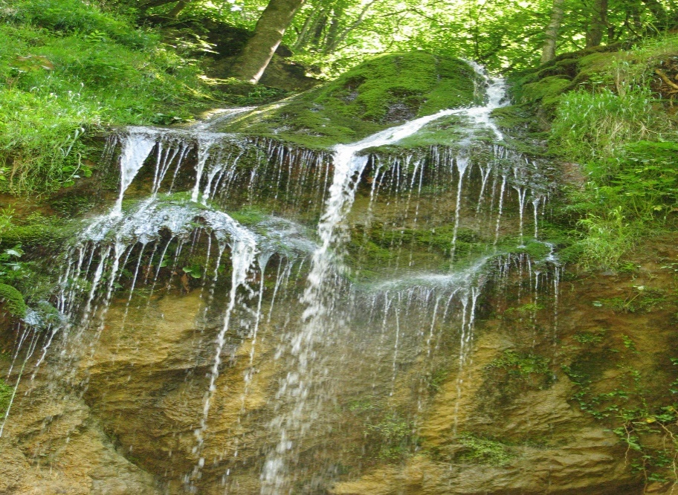
Samoborsko gorje
The Žumberak Mountain is a range of hills and mountains in northwestern Croatia and southeastern Slovenia, extending from the southwest to the northeast between the Krka and the Kupa. It covers an area of 430 km².

Slide 13
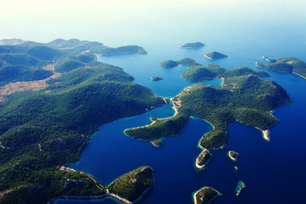
Lastovsko otočje
Lastovsko otočje (Lastovo archipelago) belongs to the outer group of islands in south Dalmatia and includes the island of Lastovo with neighbouring islands, island groups Lastovnjaci and Vrhovnjaci and island Sušac, consisting of the total of 44 islands, islets and reefs.
It is distinguished by special inland flora and fauna features as well as by its wealth and diversity of marine flora and fauna and exceptional landscape beauty.

Slide 14
Sources:
http://www.zastita-prirode.hr/eng/Protected-Nature/Protected-Areas/Nature-parks
https://www.parkovihrvatske.hr/parks
https://en.wikipedia.org/wiki/Protected_areas_of_Croatia

